Slide 1

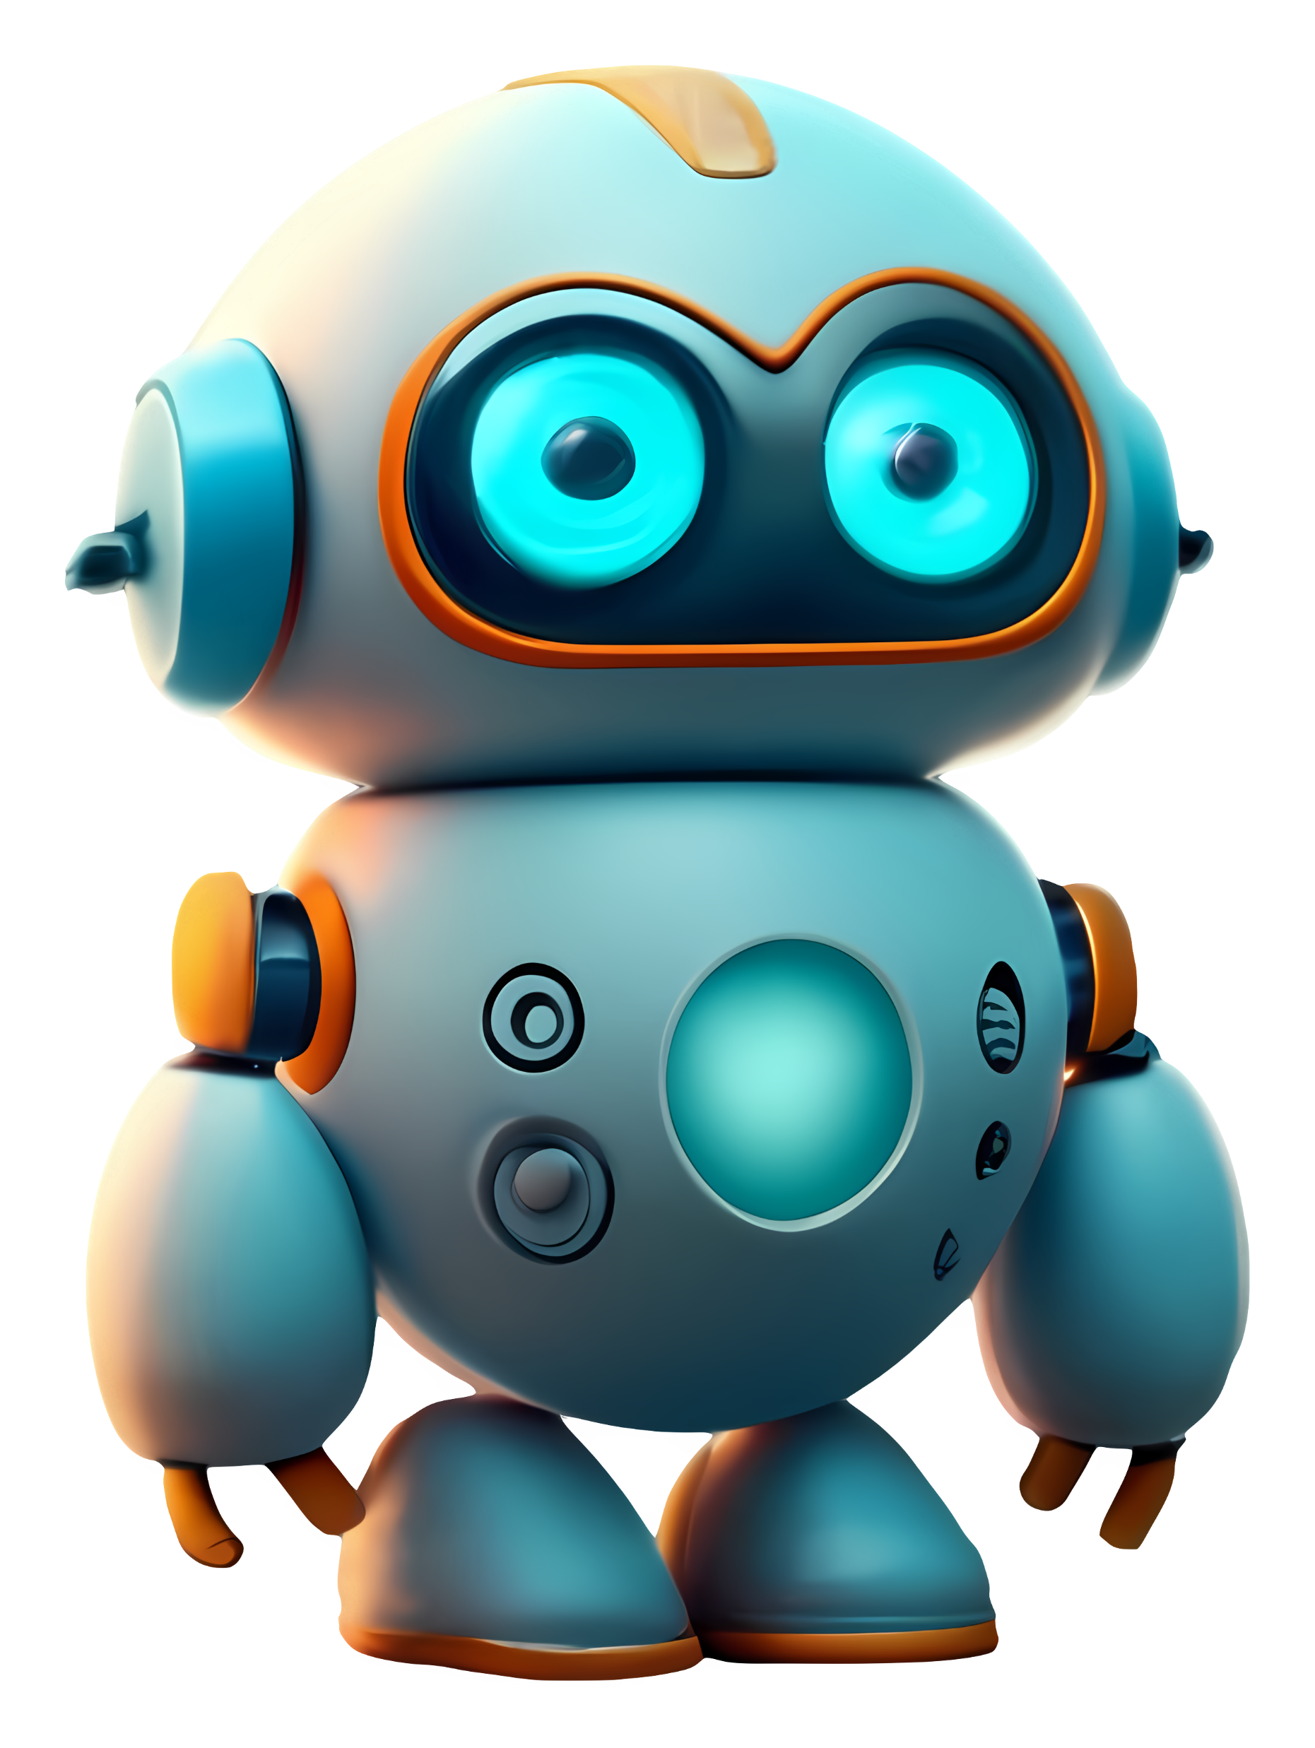


Slide 2


mAIte
is an innovative chatbot project developed for text generation, image generation, and motion generation, utilizing cutting-edge technologies such as React JavaScript, Material-UI, Node.js, and Axios
Notes:
Elevator pitch
mAIte is an innovative chatbot project developed for text generation, image generation, and motion generation, utilizing cutting-edge technologies such as React JavaScript, Material-UI, Node.js, and Axios.

Slide 3


Description
Motivation for Development
Text Generation: generates contextually relevant text based on user inputs.
Image Generation: generates dynamic images based on specific queries or interactions.
Motion Generation: creates animations and dynamic visual effects.
Combining AI features in a single platform, allowing users to access AI technology to meet a variety of day-to-day needs and requests
Notes:
Concept
1- Description
Text Generation: generates contextually relevant text based on user inputs.
Image Generation: generates dynamic images based on specific queries or interactions.
Motion Generation: creates animations and dynamic visual effects.
2- Motivation for development
Combining AI features in a single platform, allowing users to access AI technology to meet a variety of day-to-day needs and requests

Slide 4


User story
As an app user…
I WANT to obtain intelligent, responsive answers to my questions
I WANT to generate personalised still and animated images based on my specific criteria
SO THAT I can access the information I need and create images that meet my needs
Notes:
Concept
3- User story:
As an app user…
I WANT to obtain intelligent, responsive answers to my questions
I WANT to generate personalised still and animated images based on my specific criteria
SO THAT I can access the information I need and create images that meet my needs

Slide 5


Process
Technologies used
React JavaScript, Material-UI,
Node.js, Axios
Chris – Design, Use of Material-UI, HTML, CSS
Theo – Image Generator API request/response
Ola – ChatBot API request/response
Avraaj – AI APIs, Repository, Deployment
Joana – Video API search, Chat History component
Swathi – File structure, corrections, general support
Breakdown of tasks and roles
Notes:
Process
Technologies used
React JavaScript, Material-UI, Node.js, Axios
Breakdown of tasks and roles
Chris – Design, Use of Material-UI, HTML, CSS
Theo – Image Generator API request/response
Ola – ChatBot API request/response
Avraaj – AI APIs, Repository, Deployment
Joana – Video API search, Chat History component
Swathi – File structure, corrections, general support

Slide 6
Process
Challenges
Finding workable AI APIs
Using new technologies, like Material UI
APIs for ChatBot and Image Generation successfully implemented
Successful manipulation of new technologies
Completing full project using React.js
Successes
Notes:
Process
Challenges
Finding workable AI APIs
Using new technologies, like Material UI
Successes
APIs for ChatBot and Image Generation successfully implemented
Successful manipulation of new technologies
Completing full project using React.js

Slide 7
Demo

Slide 8
Directions for future development
Consider adding text to speech API which we were unable to make work within the limited timeframe
Make small changes to design to ensure it is clean and intuitive
Use more up-to-date ChatBot API
Notes:
Directions for future development
Consider adding text to speech API which we were unable to make work within the limited timeframe
Make small changes to design to ensure it is clean and intuitive
Use more up-to-date ChatBot API

Slide 9
GitHub Project Repo Link:
https://github.com/Avr99j/m_AI_te
Deployed page:
https://maite9.netlify.app/
Notes:
Links
GitHub Project Repo Link:
https://github.com/Avr99j/m_AI_te
Deployed page:
https://maite9.netlify.app/

